Slide 1
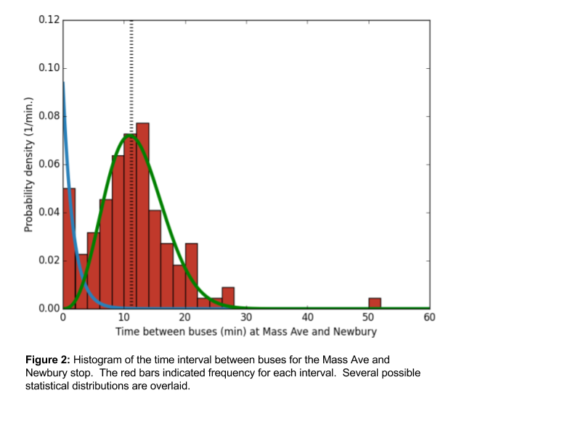
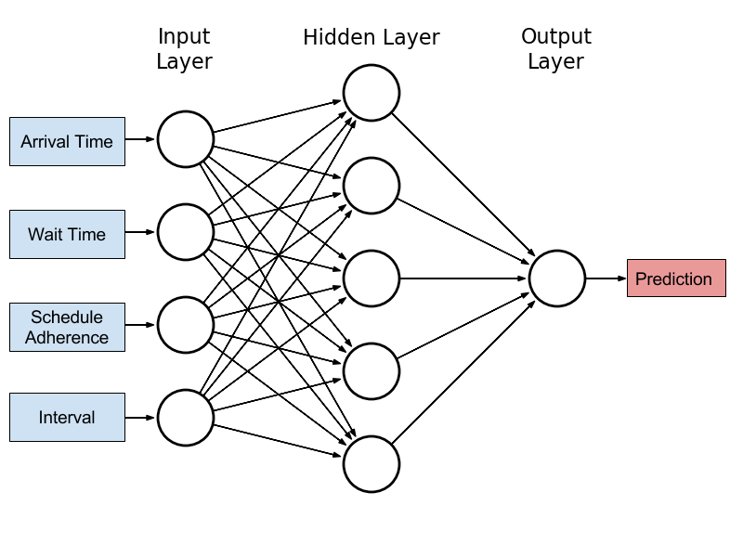
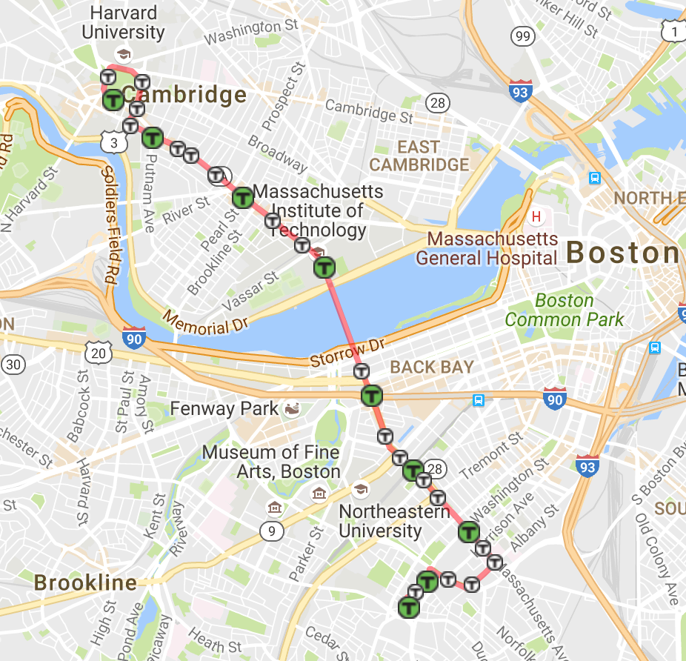
EECS
MIT EECS Undergraduate Research
and Innovation Scholar
Neural Nets for Bus Arrival Time Prediction
Cooper Sloan, Alan Edelman, Jiahao Chen
PROBLEM
ARCHITECTURE
Predict arrival times -> optimize network traffic
Important: Accurate Bus Arrival Prediction Times
Machine learning and Statistical models and
Limited in their accuracy
Massachusetts Bay Transportation Authority dataset
Goal: accurately predict bus arrival times
Statistical Models: Poisson Distribution and Gaussian Unitary Ensemble¹
Machine learning: neural nets²
Proposed solution: deep neural net combined with statistical model
Model trained across several years of data
Root Mean Square Error
APPROACH
1 bus: between Boston and Cambridge
GPS data from the MBTA
Data partitions: daily, weekly, season
Relevant Features: schedule adherence, dwell time
Features: inputs to data model
Model outputs predicted arrival time
Figure 2: Histogram of bus arrival time intervals
Figure 3: Sample neural net architecture⁴
NEXT STEPS
Refine models and determine best predictors for bus arrival time
Compare accuracy of models across routes
Determine online method to generate real time predictions
Works Cited
Krbálek, Milan, and Petr Seba. "The statistical properties of the city transport in Cuernavaca (Mexico) and random matrix ensembles." Journal of Physics A: Mathematical and General 33.26 (2000): L229.
Jeong, Ranhee, and Laurence R. Rilett. "Bus arrival time prediction using artificial neural network model." Intelligent Transportation Systems, 2004. Proceedings. The 7th International IEEE Conference on. IEEE, 2004.
Figure 1: 1 Bus route through Boston and Cambridge

